Slide 1
Language Model Reasoning: Chain-of-Thought
Owen Ma
Washington University in St. Louis
Spring 2024, CSE 561

Slide 2
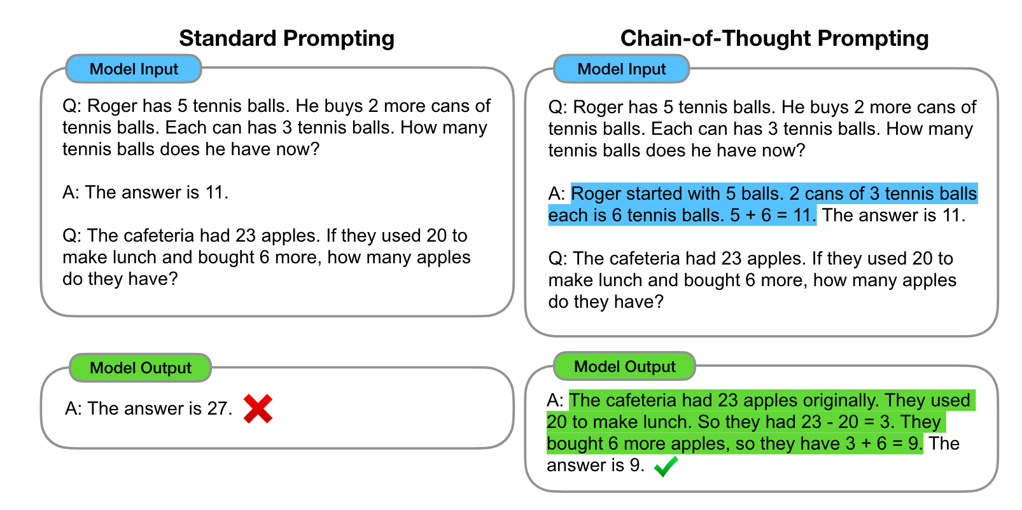
1

Slide 3
What is Chain-of-Thought:
a coherent series of intermediate reasoning steps that leads to the final answer for a problem
Ex.
math word problems: originally, she had …, her sister had …. So in total …. After spending …, they had …. Hence the answer is …
commonsense reasoning: Yes or No: Would a pear sink in water? density of a pear is about 0.6 g/cm³, which is less than water. Objects less dense than water float. Thus a pear would float. So the answer is no.
2

Slide 4
Chain-of-Thought Prompting
Prior Works on giving language models the ability to generate natural language intermediate steps:
training from scratch
finetuning a pretrained model
They are computationally inefficient and it is costly to create a large set of high quality rationales for training.
3

Slide 5
Chain-of-Thought Prompting
But large language models offer the prospect of in-context few-shot learning via prompting.
Hence, in Chain-of-Thought Prompting Elicits Reasoning in Large Language Models (Wei et. al, 2022):
designed prompts that consist of triples: <input, chain-of-thought, output>.
Their empirical results show that, for sufficiently large language models, chain-of-though prompting not only outperforms standard prompting, but can also achieve state-of-the-art performance on some benchmarks.
4

Slide 6
Experimental Setup
Benchmarks:
Arithmetic: GSM8K, SVAMP, AQuA …
Commonsense: CSQA, StrategyQA …
Symbolic: two toy tasks: last letter concatenation & coin flip
5

Slide 7
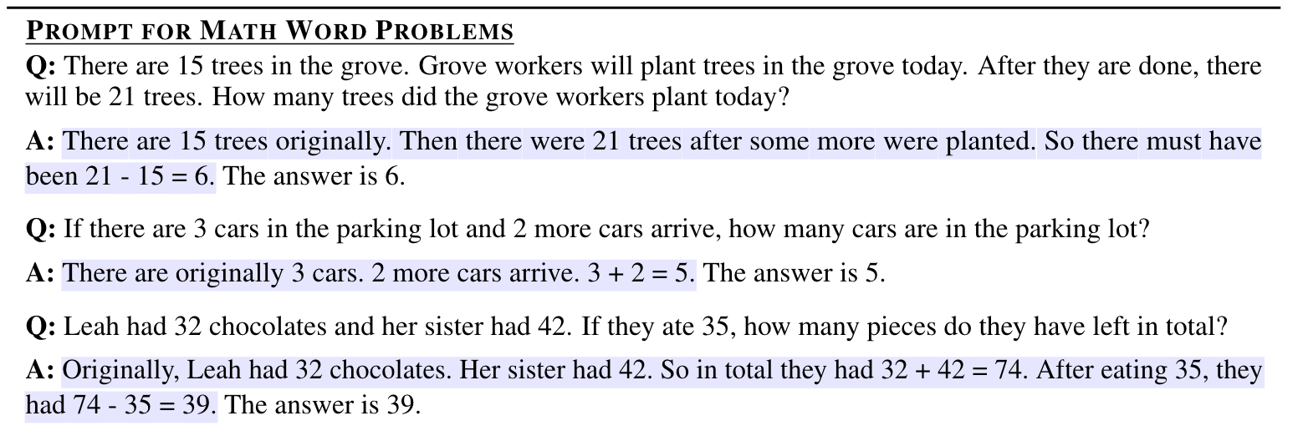
Experimental Setup - Ex CoT Prompts
Experimental Setup
6

Slide 8
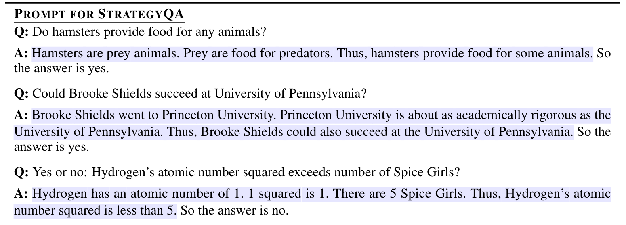
Experimental Setup - Ex CoT Prompts
Experimental Setup
7

Slide 9
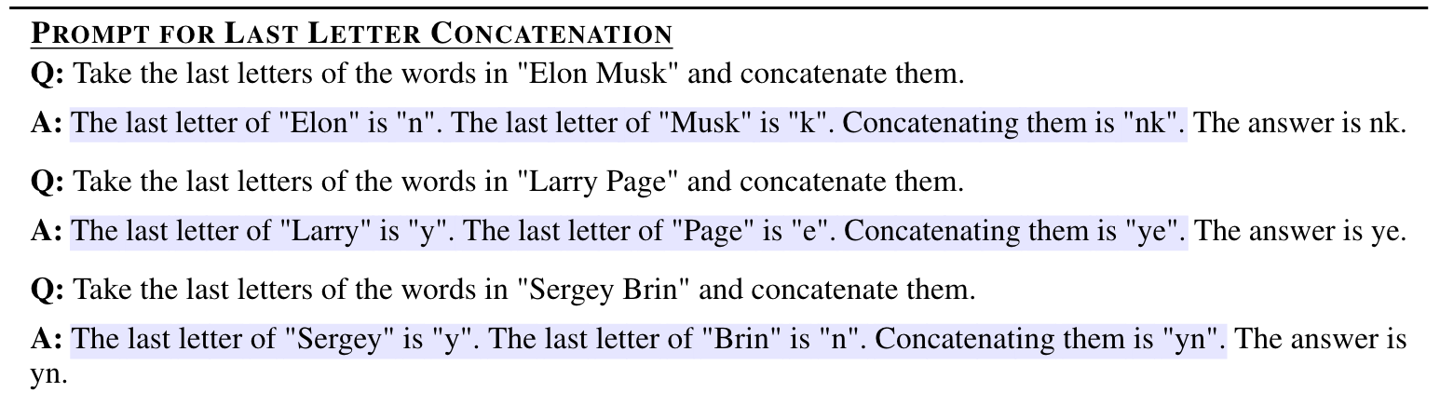
Experimental Setup - Ex CoT Prompts
Experimental Setup
8

Slide 10
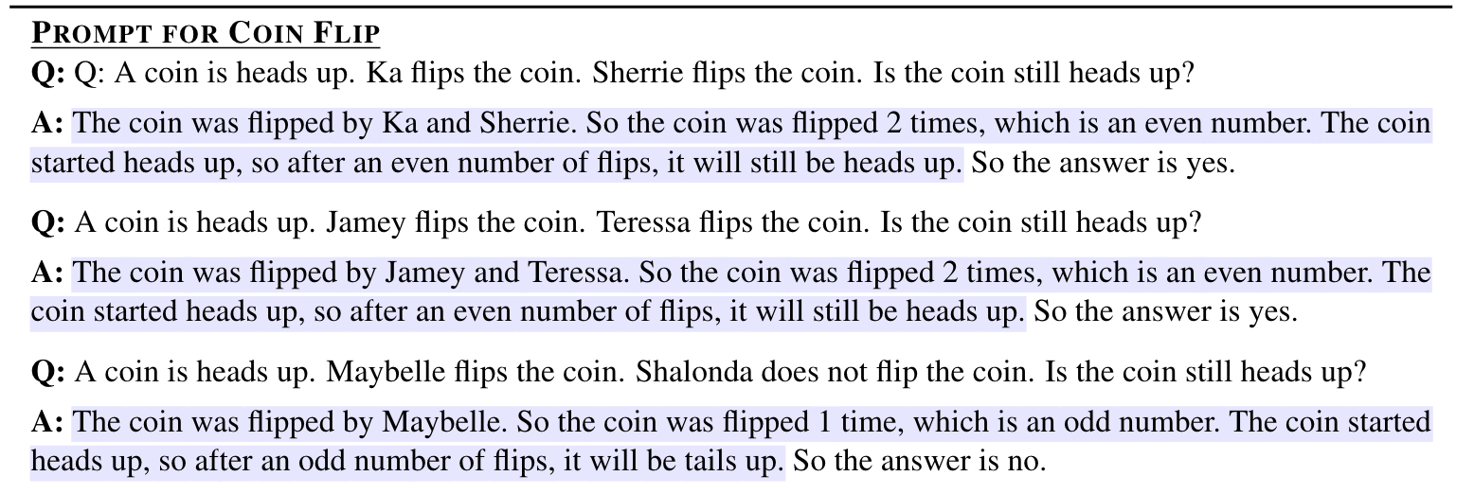
Experimental Setup - Ex CoT Prompts
Experimental Setup
9

Slide 11
Experimental Setup
Prompts:
standard prompting: standard few-shot prompting where language models are given input-output pairs;
Chain-of-thought Prompting: manually composed a set of 8 few-shot exemplars with chains of thought
10

Slide 12
Experimental Setup
Language Models:
GPT-3: 350M, 1.3B, 6.7B, 175B parameters
LaMDA: 422M, 2B, 8B, 68B, 137B parameters
PaLM:8B, 62B, 540B parameters
UL2: 20B parameters
Codex: code-davinci-002
(Interesting note: OpenAI had retired all the models that were used in this paper, along with many others, and “recommended replacement: gpt-3.5-turbo-instruct or gpt-4)” XD
11

Slide 13
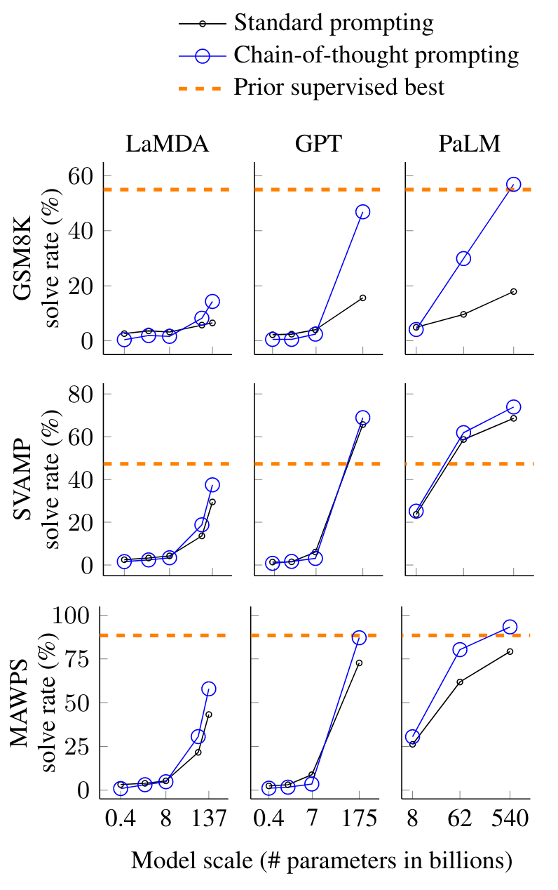
Results
Math word Problems
12
Notes:
An interesting preview question I saw was: Is Chain-of-Thought prompting strengthening shallow heuristics to give better results, or actually eliciting good math arithmetic reasoning abilities?
So, in the paper that introduced the dataset SVAMP, they explicitly analyzed this problem: shallow heuristic simply means that the model is picking up the rules that link description of the problem and the solution; basically, it means that without even looking at the problem, the models pick up on some superficial patterns and solve the problem.
However, I believe that the question how transformers reason (or even the question is transformers reasoning) is still an open problem, in this paper the authors did say that cot is designed to emulate the thought process of human, but it does not really say anything about how these neural networks reason.
However, one thing we do need to note is that, in the paper that introduced SVAMP, so the paper that discusses this concern of using shallow heuristic instead of actually reasoning about math, the models they evaluated were very old, they were LSTM models and they are very different from these transformer language models. Additionally, GSM8K is a more challenging datasets and here the empirical results show that cot prompting has a lot of practical values even though it does not answer the deeper philosophical question of how these neural networks reason.

Slide 14
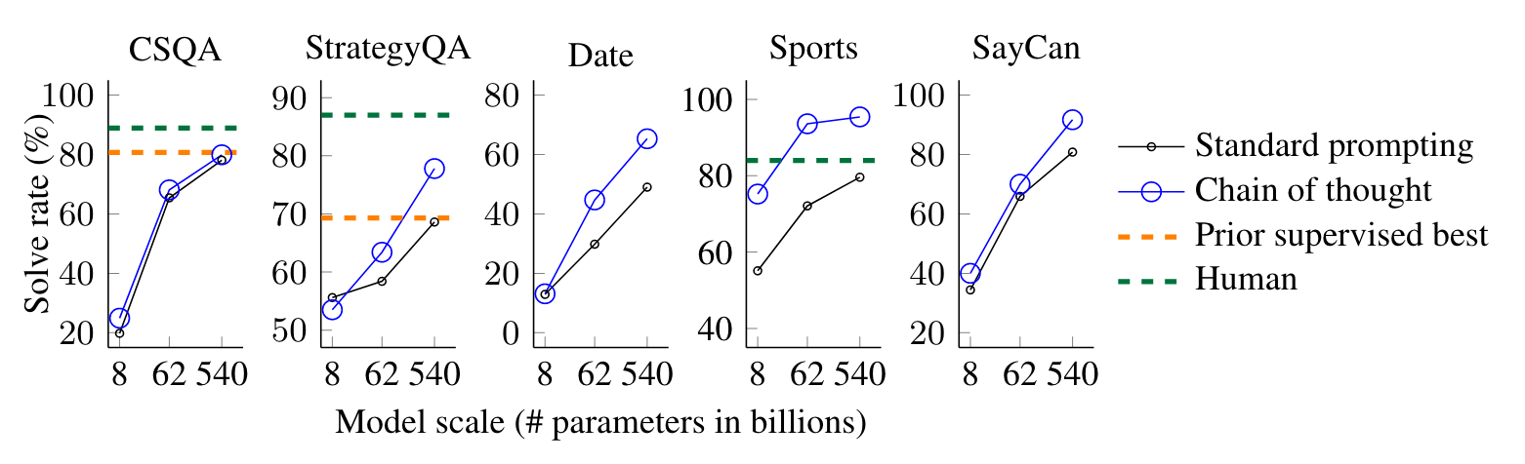
Results
Commonsense Reasoning Tasks
The language model shown here is PaLM.
13

Slide 15
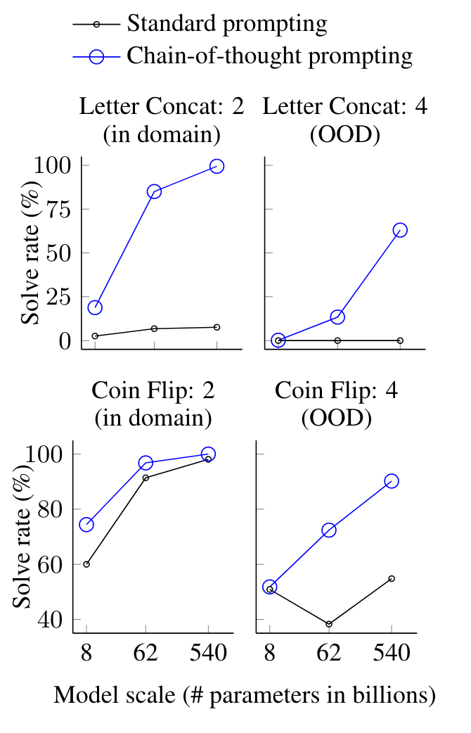
Results
Symbolic Reasoning Tasks
in domain: test set had the same number of steps as the few-shot exemplars
OOD (out of domain): test set had more steps than those in the exemplars
(Model shown here is PaLM)
14a
Notes:
How does the scalability of models influence the ability to generalize in-domain or out-of-domain tasks in symbolic reasoning?
as we can observe from these plots, as language models get larger in scale, their symbolic reasoning abilities consistently increase when cot prompting is used. In fact, now, if you try these two tasks with chatgpt for example, without any prompt engineering, it can pretty much successfully solve them 100% of the time.

Slide 16
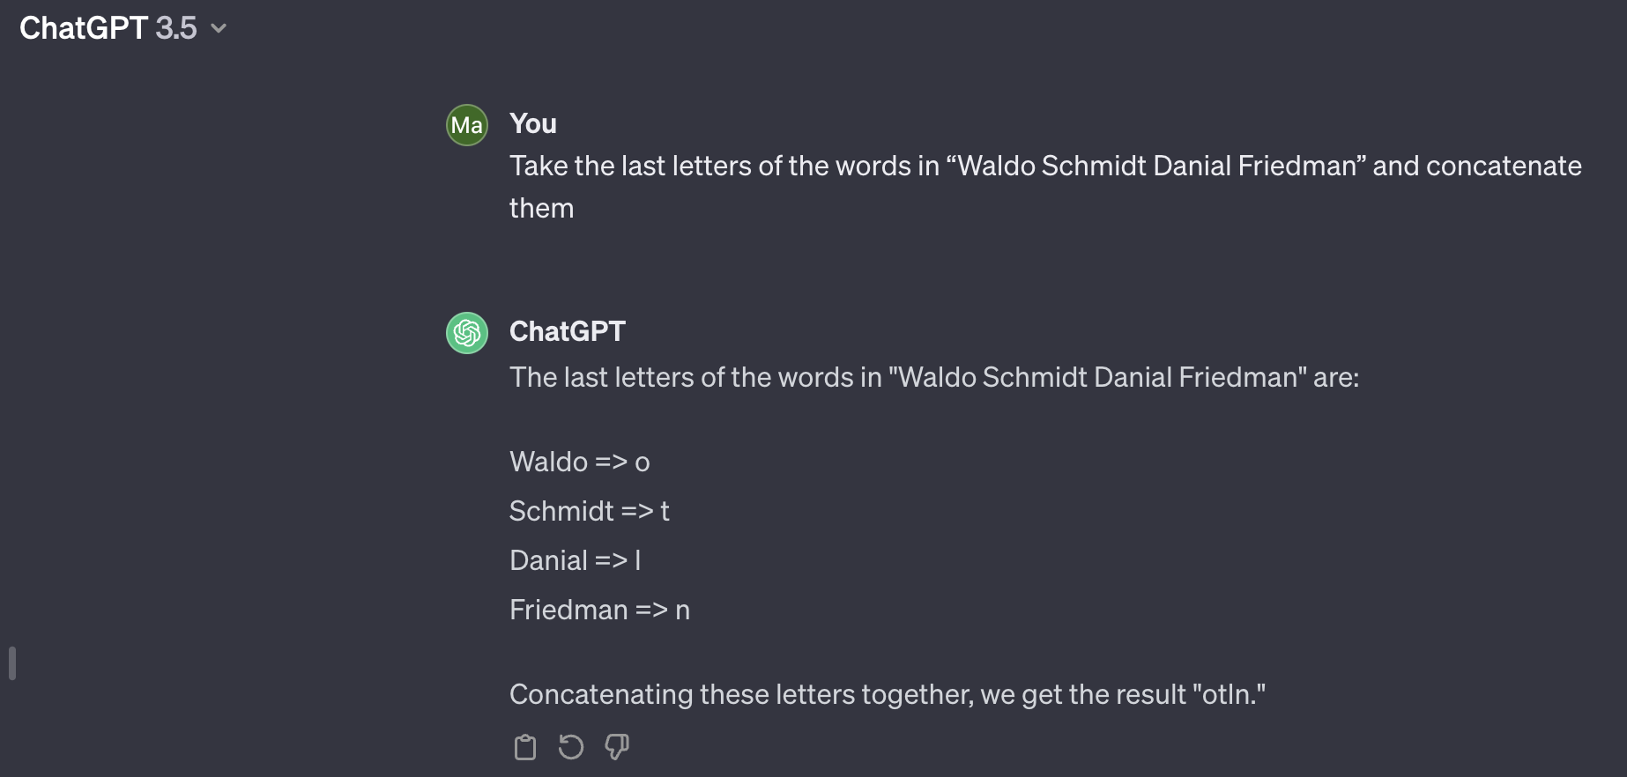
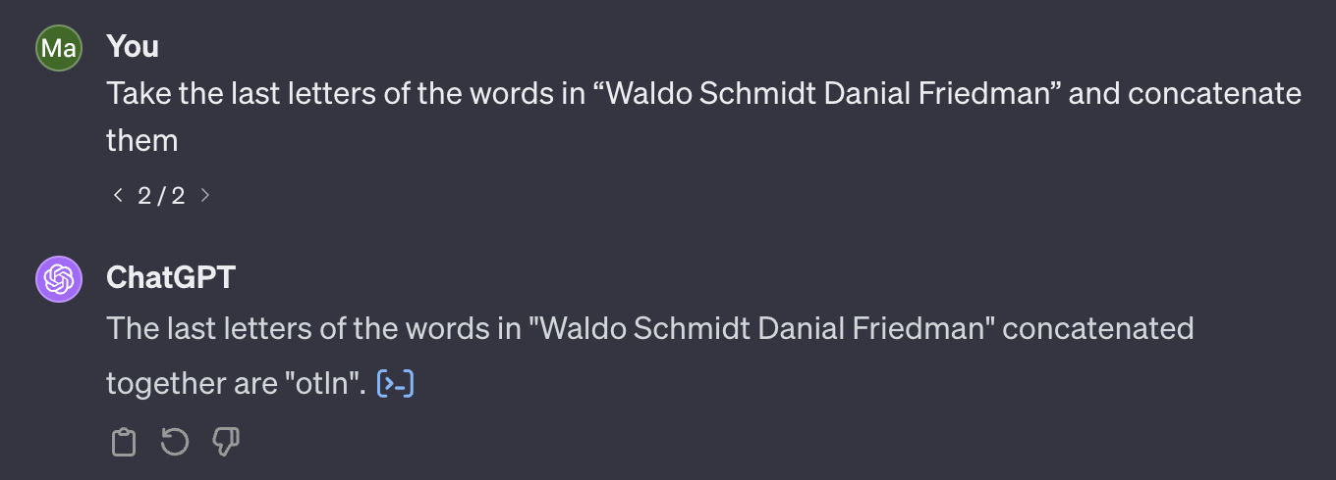
Results
Symbolic Reasoning Tasks
14b
Notes:
one preview question was How does the scalability of models influence the ability to generalize in-domain or out-of-domain tasks in symbolic reasoning?
as we can observe from these plots, as language models get larger in scale, their symbolic reasoning abilities consistently increase when cot prompting is used. In fact, now, if you try these two tasks with chatgpt for example, without any prompt engineering, it can pretty much successfully solve them 100% of the time.

Slide 17
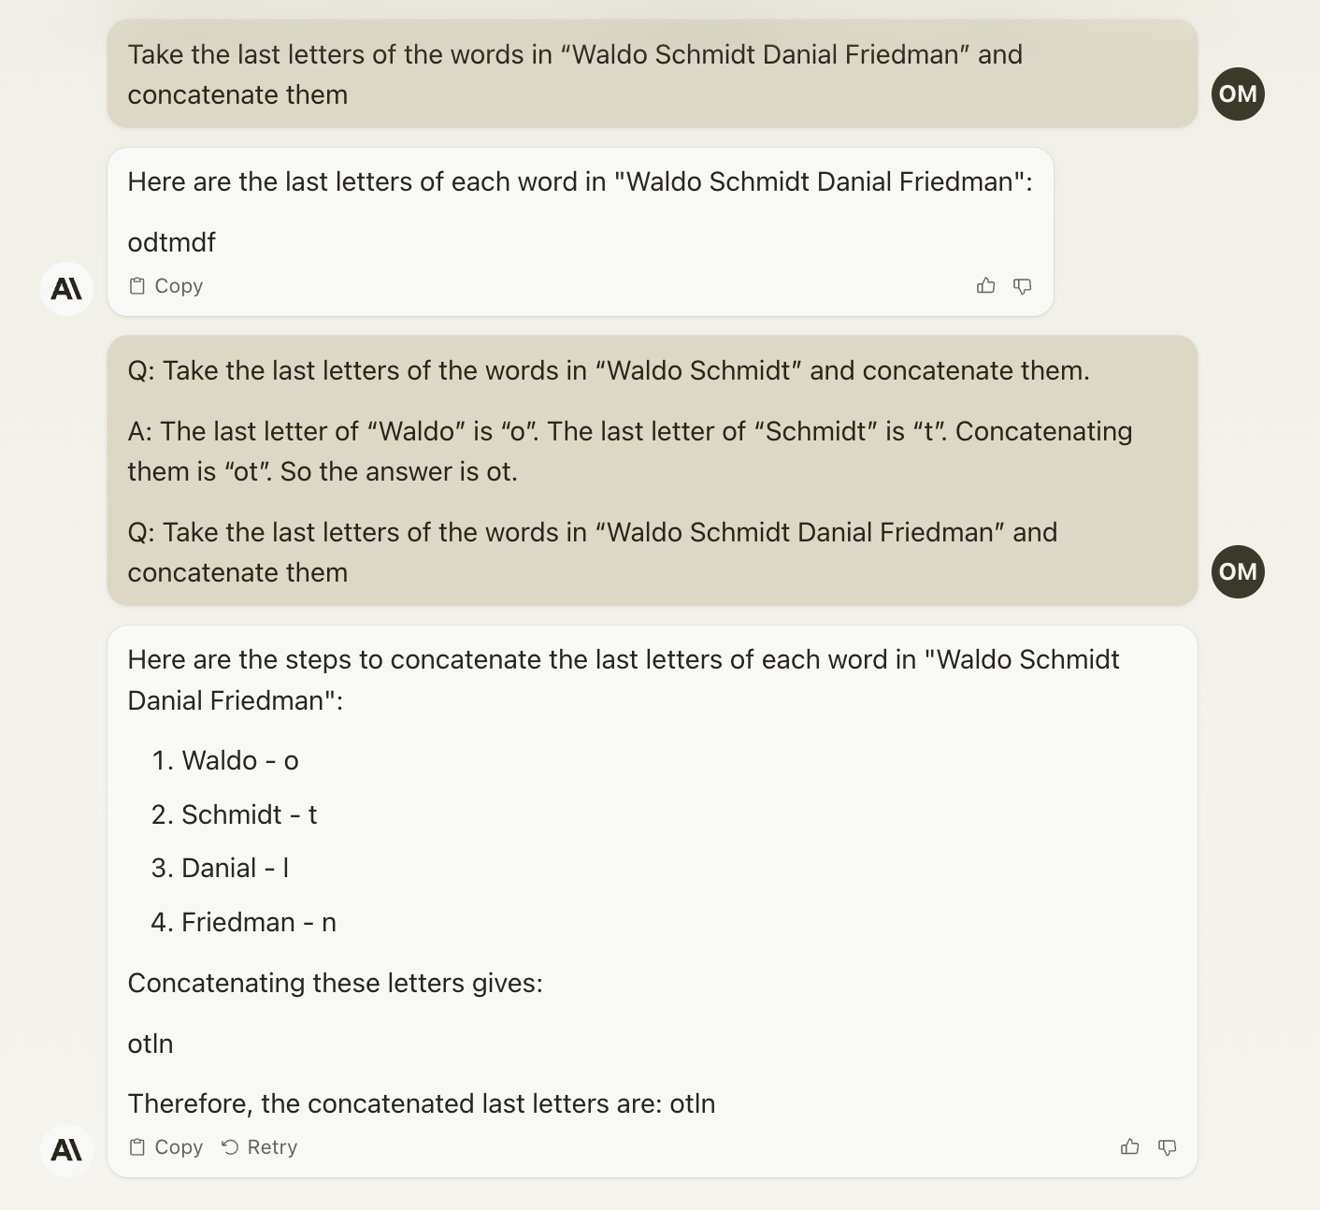
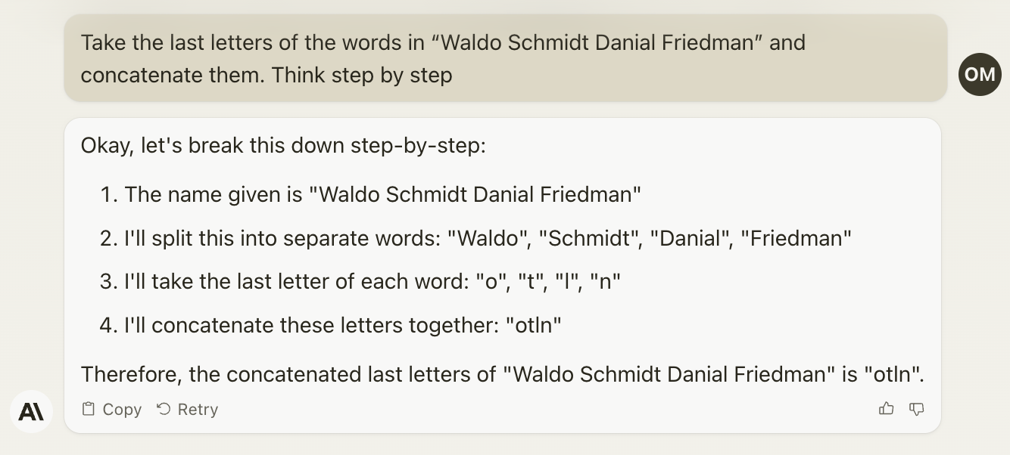
Results
Symbolic Reasoning Tasks
14c
Notes:
but on claude 2, the power of cot prompting can still be observed
in fact, we can use zero-shot cot prompting to get the correct answer
this is not to say that calude 2 is not as smart as chatgpt, claude is one of the closest competitors to chatgpt but they are finetuned differenty which could be the reason why we observe this difference.

Slide 18
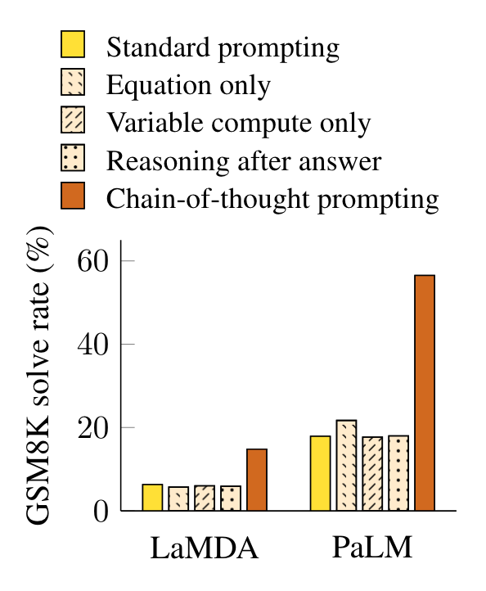
Ablation Study & Robustness
Equation: model is prompted to only give an equation before the final answer
Variable compute: to answer the question whether chain-of-thought improves performance by allowing the model to spend more computation
Reasoning after answer: this suggests that the sequential reasoning in chain-of-thought is useful beyond simply activating knowledge
15
Notes:
getting back to the cot paper, they also conducted ablation study to answer if the same performance increase can be achieved via other formats of prompting
equation: does not help much which suggest that a single equation is not enough to capture the semantics of the questions in GSM8K dataset
variable compute: the model is prompted to output a sequence of dots equal to the number of characters in the equation needed to solve the problem; this performs about the same as baseline standard prompting so simply outputting longer answers is not the reason why cot works
reasoning after answer: the question is perhaps cot simply allows the model to better access knowledge acquired during pretraining, if this is the case, placing cot after the answer should also improve performance, but as we can see, this variant performs about the same as the baseline, which suggests

Slide 19
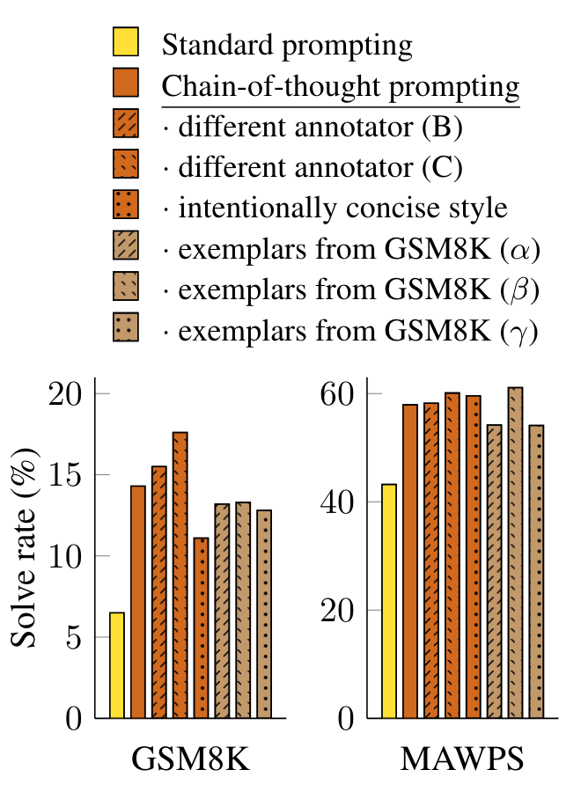
Ablation Study & Robustness
sensitivity to exemplars is a key consideration for prompting approaches
these experiments show that successfully use of chain of thoughts does not depend on a particular linguistic style or certain exemplars used for in-context learning
16

Slide 20
One Step Further:
Wei et al. (2022) first proposed chain of thought prompting, but they only used the greedy decoding strategy.
In Self-Consistency Improves Chain of Thought Reasoning in Language Models (Wang et al., 2022): they introduced a new decoding strategy: Self-Consistency
The intuition is: complex reasoning tasks typically admit multiple reasoning paths.
17

Slide 21
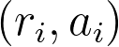

Self-Consistency
Sample a set of outputs from the language model’s decoder → the set of candidate reasoning path
can use different sampling strategies: temperature sampling, top-k sampling …
applies marginalization over all the reasoning paths by taking a majority vote over the answers arrived from the paths
Specifically:
sample multiple → take a majority vote over (the most consistent answer)
18
Notes:
temperature sampling: basically setting how creative the language model is, higher temperature will give more diverse and surprising outputs; temperature = 0 is essentially greedy search
top-k sampling: basically is just to keep the top-k most likely next words
another very similar sampling strategy is nucleus sampling (or top-p sampling) where we keep the most probable tokens whose summed probability mass reaches p; so essentially it is top-k sampling but with a dynamic parameter k
and as a side note, nucleus sampling would also work with self-consistency, to my understanding, I think there really isn’t a particular sampling strategy that would hurt the performance of self-consistency
r_i denotes the reasoning path, and a_i denote the answer arrived following that path

Slide 22
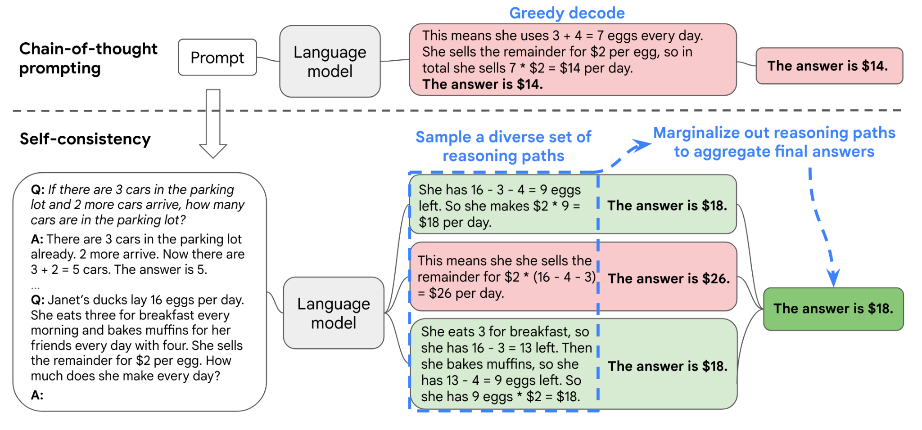
Self-Consistency
19
Notes:
One preview question is how self-consistency can avoid redundancy and repetitiveness. Perhaps I didn’t understand the question fully, but we are not really concerned with redundancy here, in fact, we would want redundant answers, if all answers are the same, it just means that either we solve the problem correctly 100% of the time, or we failed 100% of the time.
if the question is about this sampling stage, I believe all sampling is done without replacement so there won’t be identical reasoning paths, they may be similar since there are a lot of ways to capture the same semantic meaning but they won’t be identical sequences

Slide 23
Experiments Details
Datasets and Tasks: Arithmetic, Commonsense, and Symbolic reasoning (the same two toy tasks)
Language Models: UL2, GPT-3, LaMDA, PaLM
Sampling Scheme: temperature sampling and top-k sampling
20

Slide 24
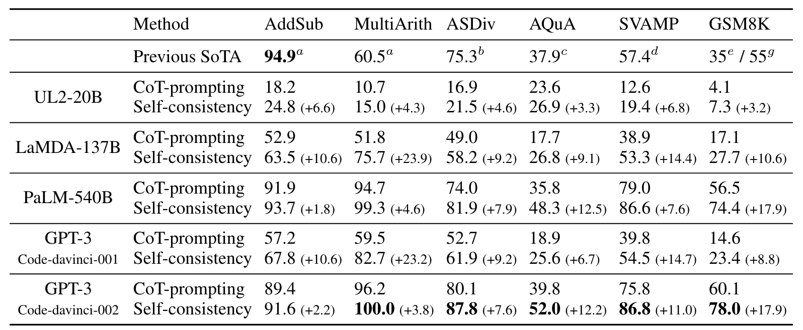
Main Results
Math word Problems
21

Slide 25
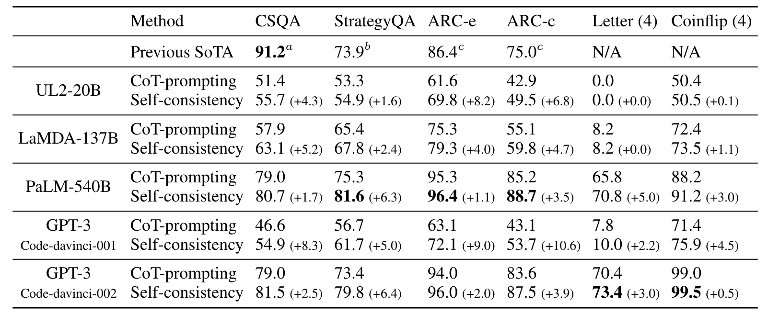
Main Results
Commonsense Reasoning Tasks
22
Notes:
and we observe the same trend here taht the gains become more significant when the language model’s scale increases

Slide 26
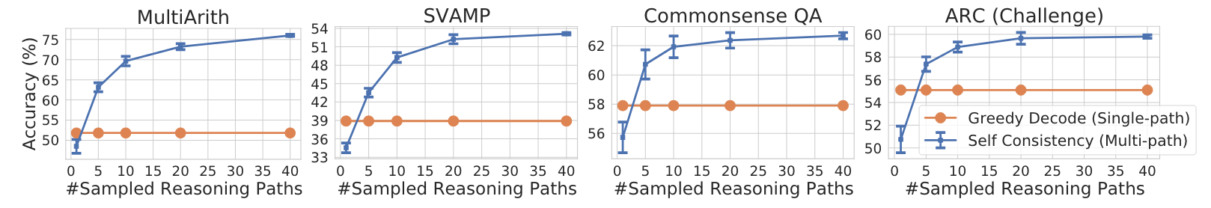
Number of Reasoning Paths
Language model here is LaMDA-137B
23
Notes:
a natural question is how many reasoning paths do you really need? Because if you need 100 paths then the computational costs skyrockets which could essentially mean that self-consistency is not that useful

Slide 27
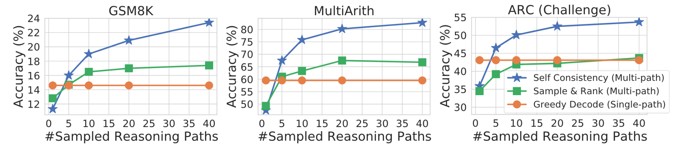
Comparison to other approaches
Sample and Rank
24
Notes:
sample and rank: sample multiple sequences from the language model decoder and rank them according to each sequence’s log probabilities

Slide 28
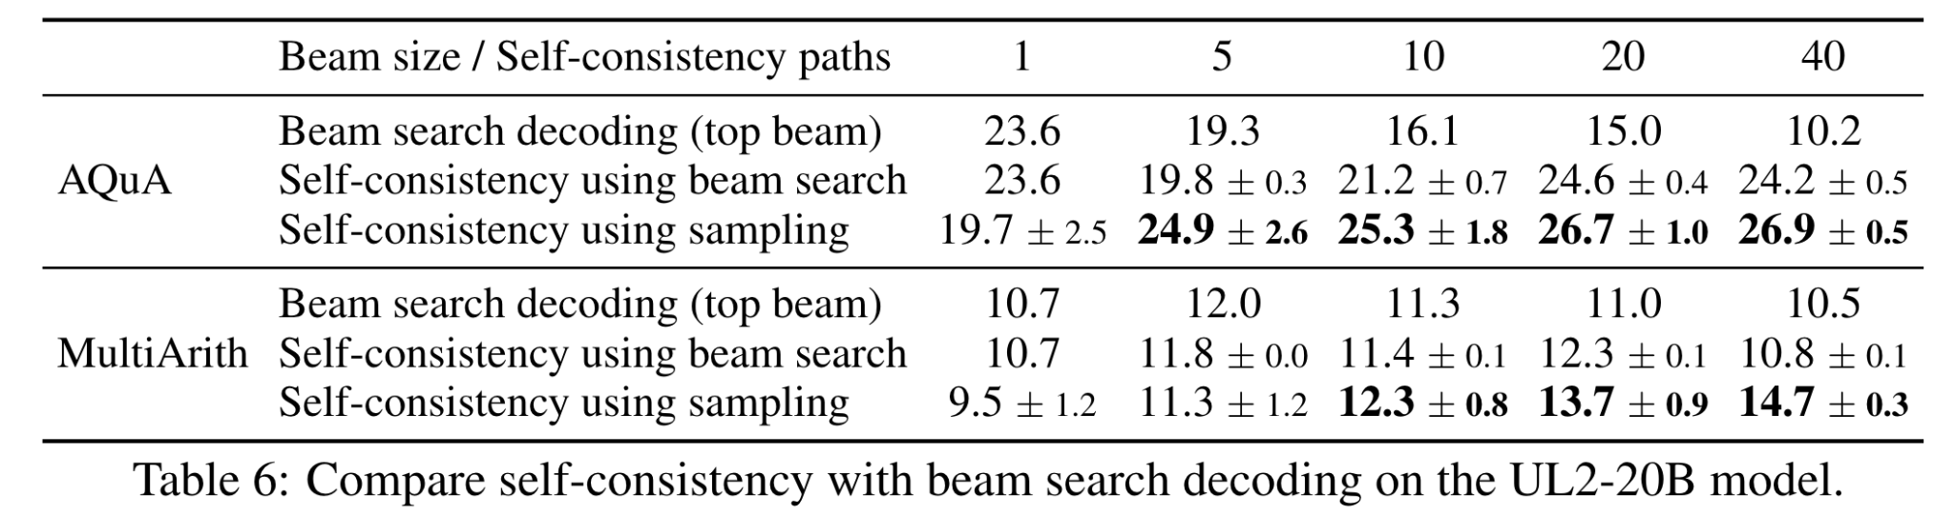
Comparison to other approaches
Beam Search
25
Notes:
beam search: basically just more general and more diverse than greedy search (essetially, beam width = 1 is greedy search)

Slide 29
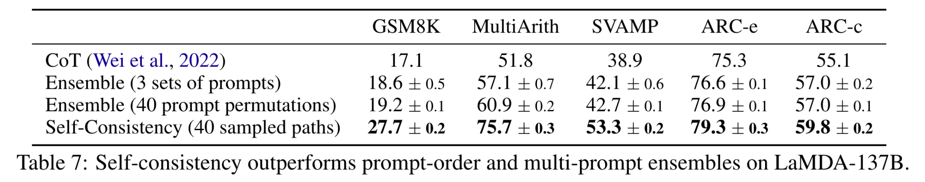
Comparison to other approaches
Ensemble
26
Notes:
here, the ensembling methods considered are permuting prompt order and using multiple sets of prompts
an interesting note is that, typically, ensemble-based approaches requiring training multiple models and aggregate their outputs; but we can note that self-consistency sort of functions like a self-ensemble on top of a single language model

Slide 30
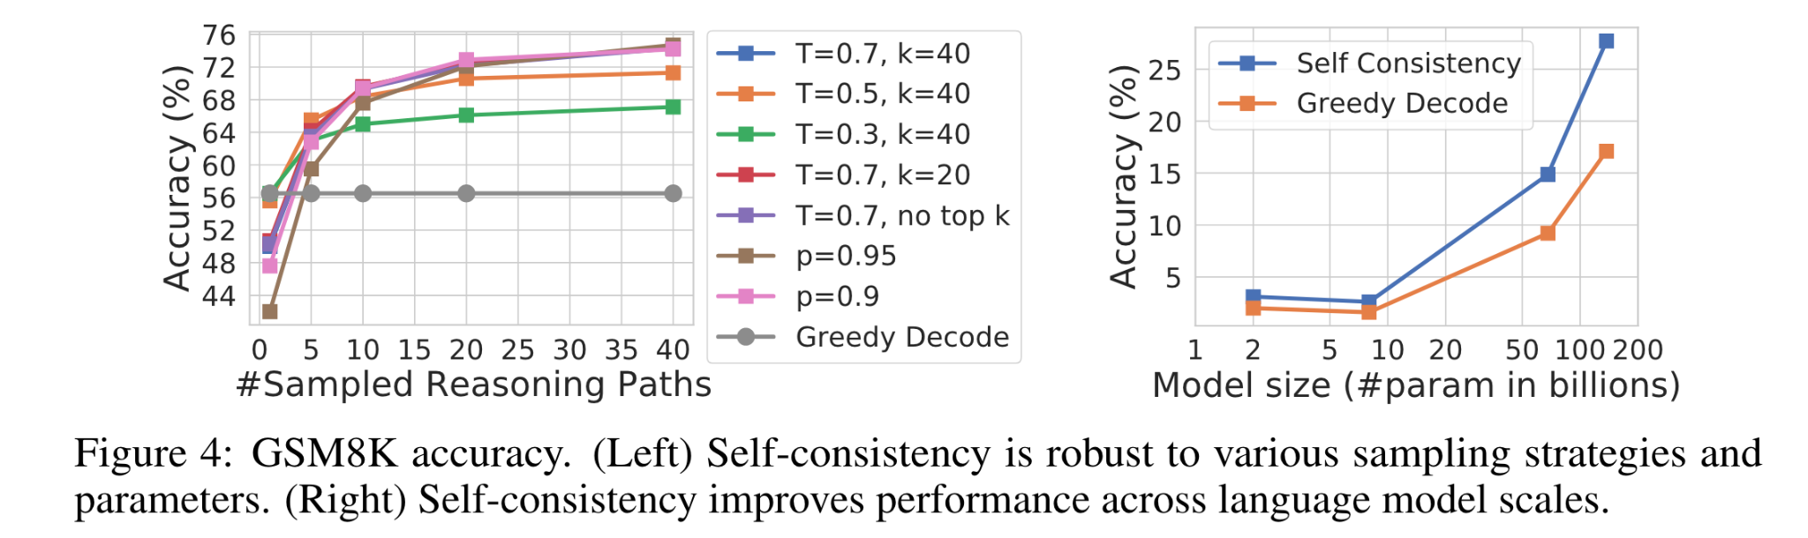
Robustness
27

Slide 31
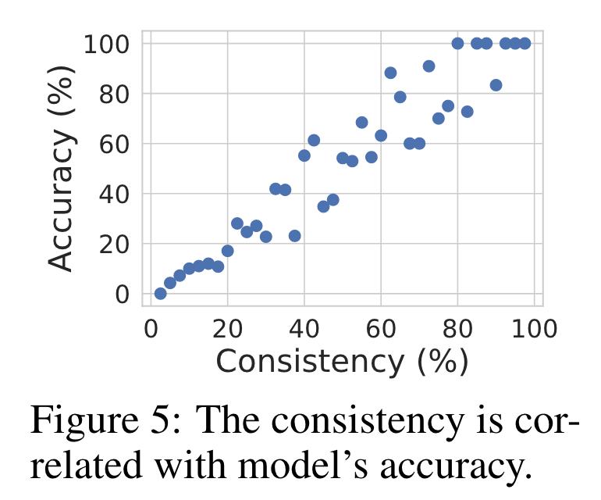
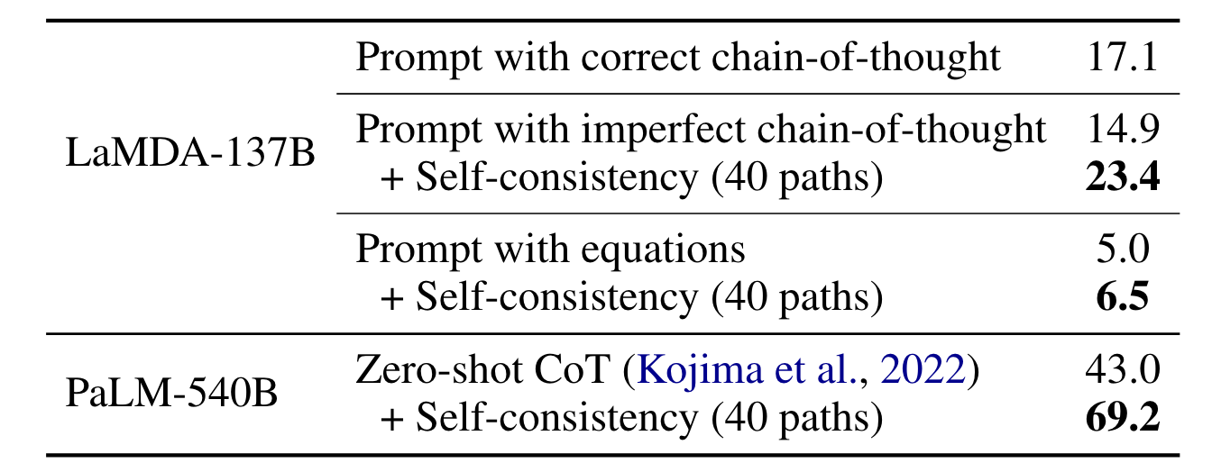
Other Interesting Results
28
Notes:
left: it suggests that one can use self-consistency to provide an uncertainty estimate of the model in its generated solutions. In other words, one can use low consistency as an indicator that the model has low confidence
one question from the preview is that can cot improve AI interpretability. I think it sort of can since it asks language models to explain the process instead of just outputting the answer, and with self-consistency, you can get a reasonable estimate of model’s confidence which is pretty useful in many tasks. However, it is not that clear if self-consistency is useful for open-ended answer generation since it is not trivial to take a majority vote over all the answers anymore simply because there is no ground truth answer.
right:
imperfect cot: for the exemplars, the reasoning steps contain mistakes;
prompts with equations is the same as we saw before where the few-shot exemplars are only the equations
the most interesting part is the last one: zero-shot cot is the sort of famous prompt - “let’s think step by step”, it’s very useful because it can be used across tasks; unlike the few-shot exemplars we have seen until now which require users to manually create task-specific chains of thought

Slide 32
Discussion & Limitation
Chain-of-thought highly depends on the inherent abilities of the language models
all results suggest that chain-of-thought generally works better on larger models
this also questions the practical value of chain-of-thought since its success only emerges at large model scales (and self-consistency only makes it more computationally costly)
A more subtle and interesting point: chain-of-thought emulates the thought processes of human, but it does not answer whether the neural network is “reasoning”
29

